Slide 1



Module One Project

Slide 2
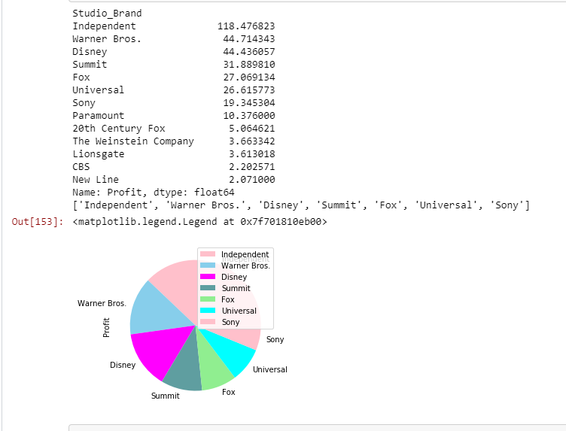
Brand Leads: Independent with Majority

Slide 3
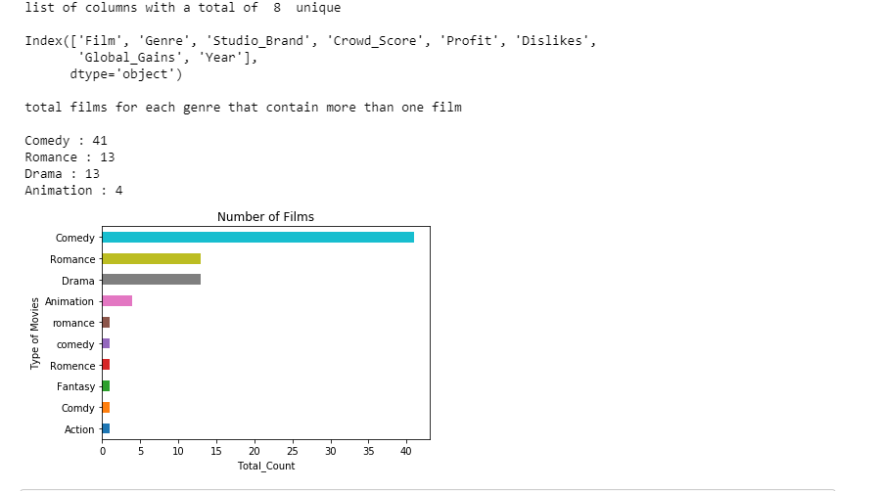
Genres containing the most films

Slide 4
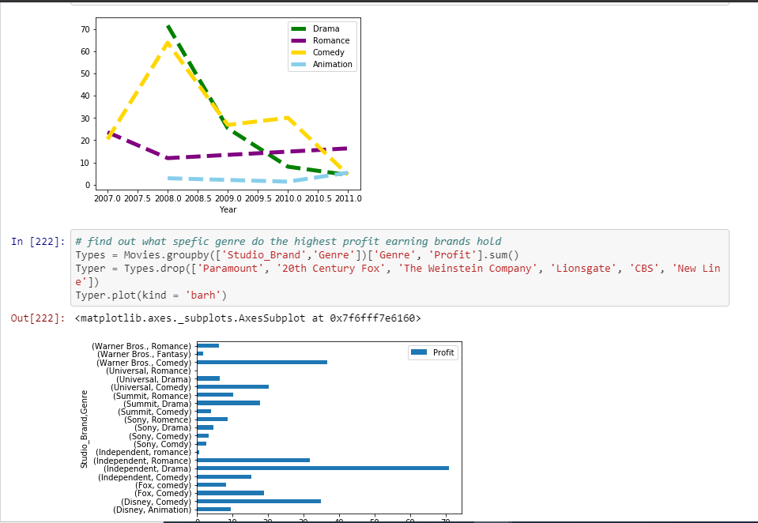
Comedy and Drama Films Win

Slide 5
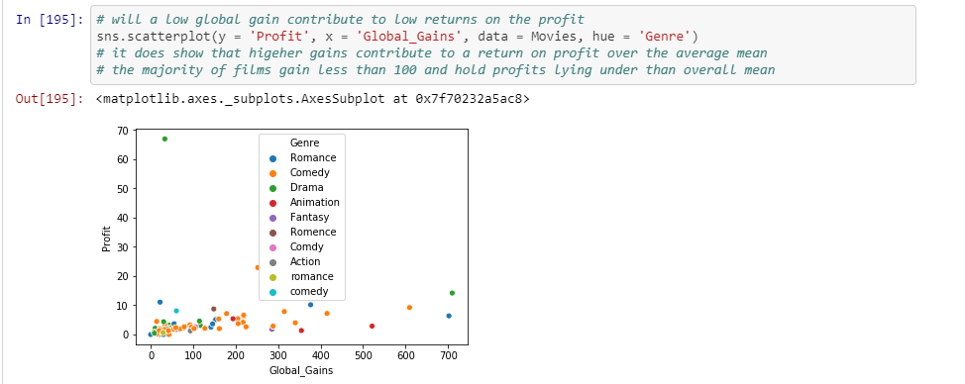
Features influence on each other are scarce

